Slide 1
Remote Debugging Guide
(WAS – Jeus 5.0.0.26)
2009. 01. 07
CODELABOR
Shin Sang Jae (codelabor@gmail.com)

Slide 2
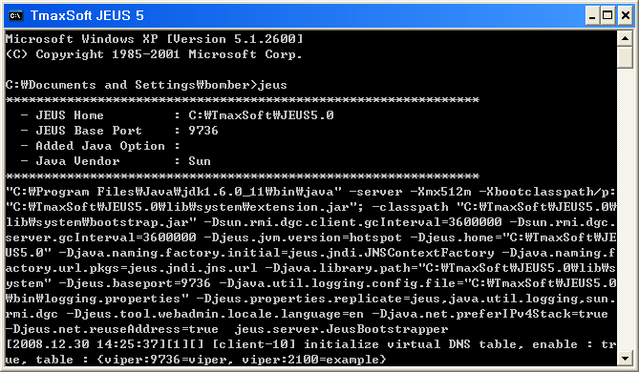
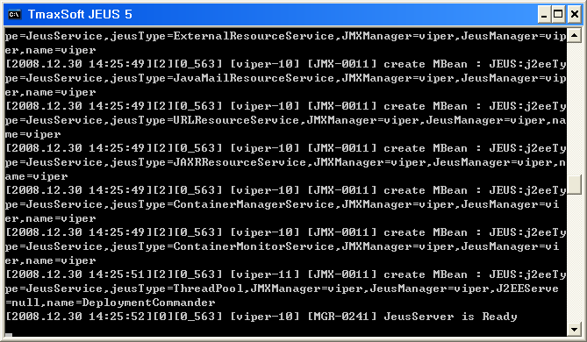
WAS Configuration
Jeus Server
Run Jeus Server
Prompt Command: jeus

Slide 3
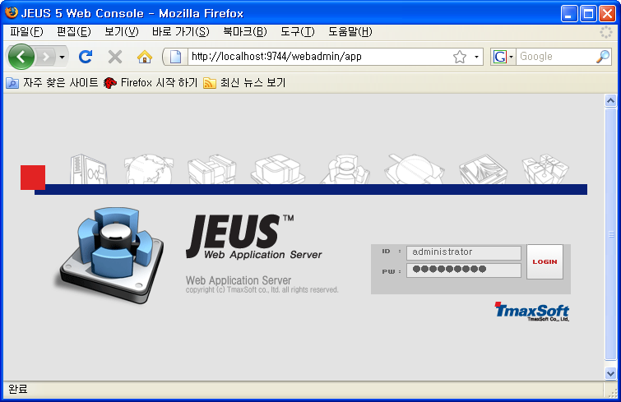
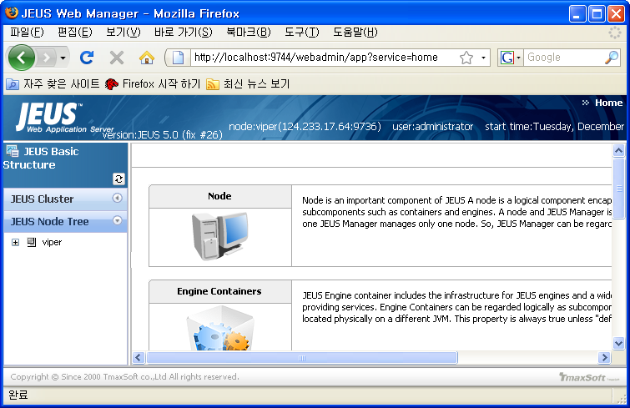
WAS Configuration
Jeus Web Admin
Run Jeus Web Admin
URL: http://localhost:9744/webadmin/app
ID: administrator
Password: jeusadmin

Slide 4
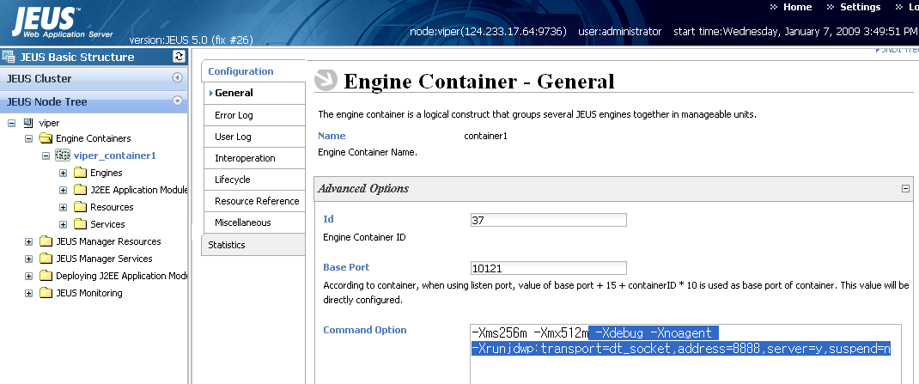
WAS Configuration
Command Option
Node > Engine Containers > node_container1
General Tab > Advanced Options
Add Commnad Option: -Xdebug -Xnoagent -Xrunjdwp:transport=dt_socket,address=8888,server=y, suspend=n
For further explanation of the debug settings, refer to the JPDA documentation.
Enter unused port

Slide 5
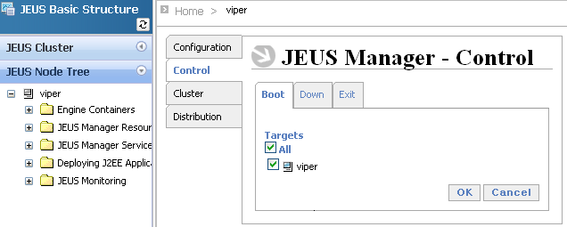
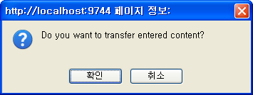
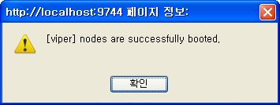
WAS Configuration
Boot Jeus Node
Node
Select control

Slide 6
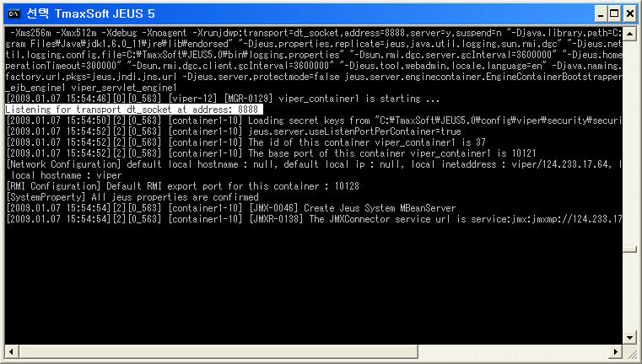
WAS Configuration
Boot Jeus Node
Check Listen Port

Slide 7
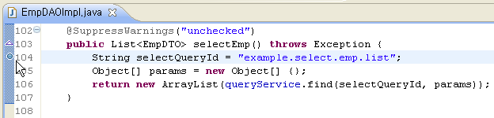
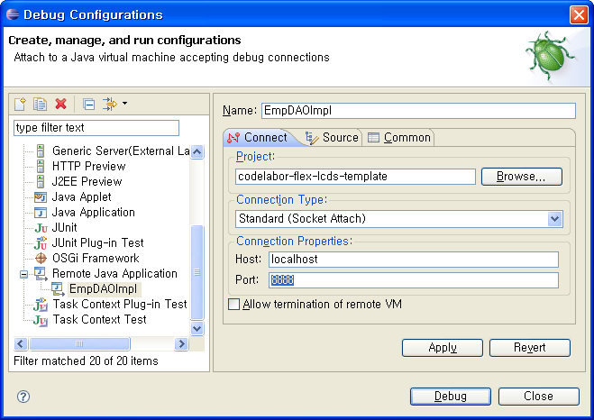
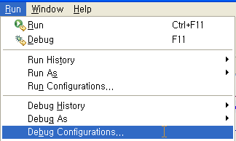
IDE Configuration
Report Listen Port
Set Break Point
Run > Run Configuration
Connection Properties > Port: 8888

Slide 8
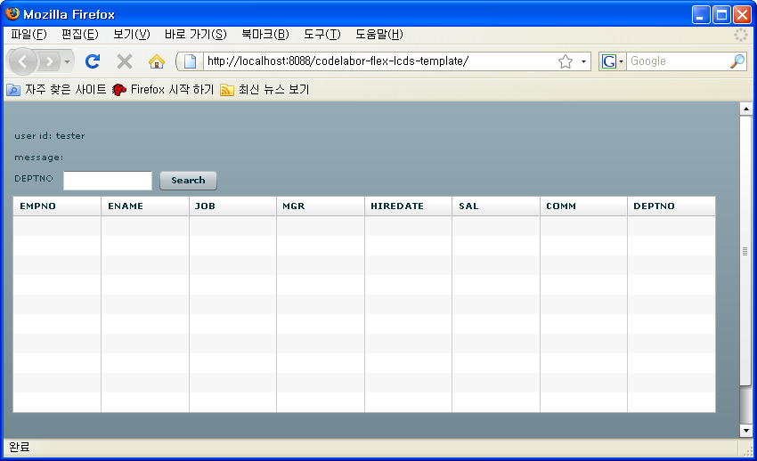
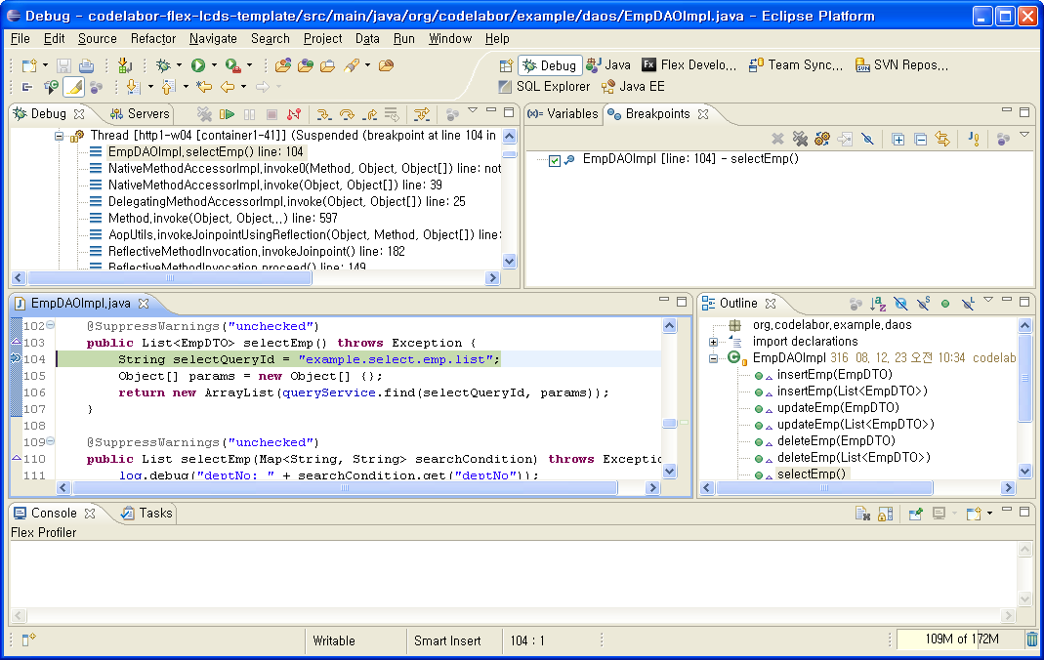
Debug
Run
Run Application
Debug

